Slide 1

Lightweight Bitcoin Client
James Donnell, Spencer Escalante,
Frankie Fasola, Trevor Silva

Slide 2
What is Bitcoin?
A distributed, decentralized digital currency system
Released by Satoshi Nakamoto 2008
Peer to Peer
$1249.88 as of April 23, 2017

Slide 3
Why Use Bitcoin?
Fast
Decentralized
Anonymity
Self control over funds
Secure

Slide 4
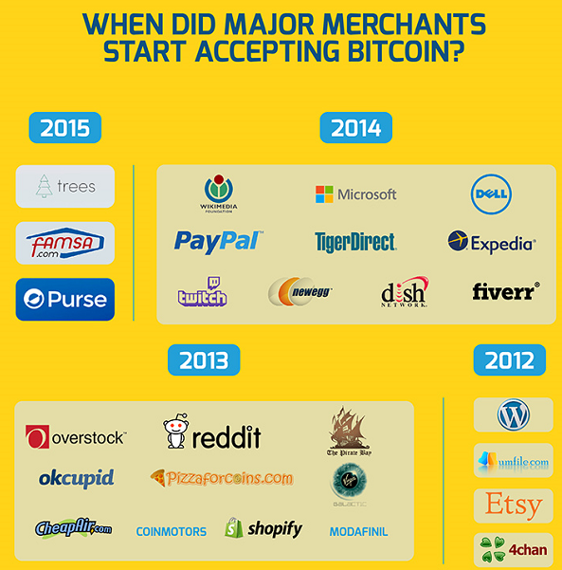

Slide 5
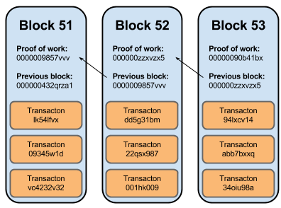
Mining
Mine is a form of record keeping
Transactions are grouped into blocks and mined
Mining is the process of finding a nonce

Slide 6
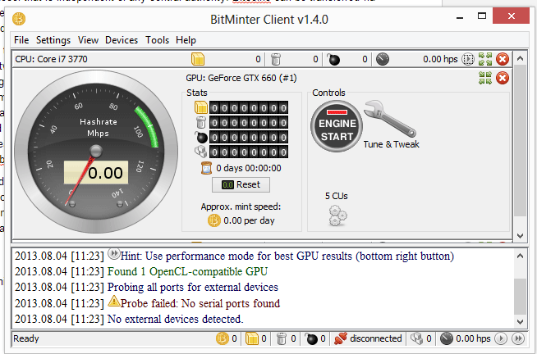

Slide 7
Nodes
Full Node
Entire block chain (130gb)
Verifies payments
Enforces Bitcoin rules
Lightweight Node
Block headers (569 kb)
Connects to full Nodes to
verify payments

Slide 8
Lightweight Bitcoin Client
Used Java libray BitcoinJ to handle backend network connections
Displayed block chain information by connecting to full nodes
Implemented a lightweight wallet to spend and receive Bitcoins

Slide 9
Questions

